Slide 1

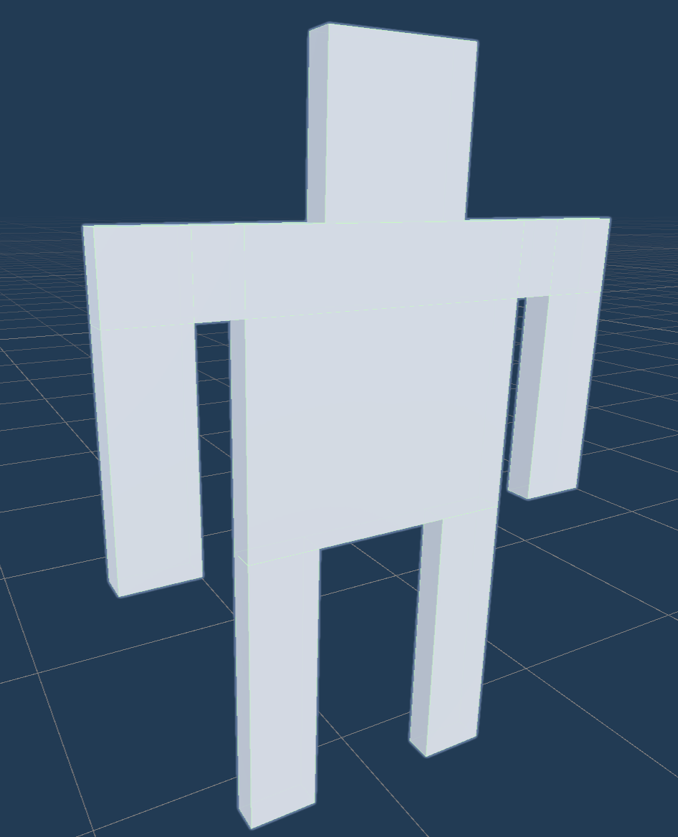
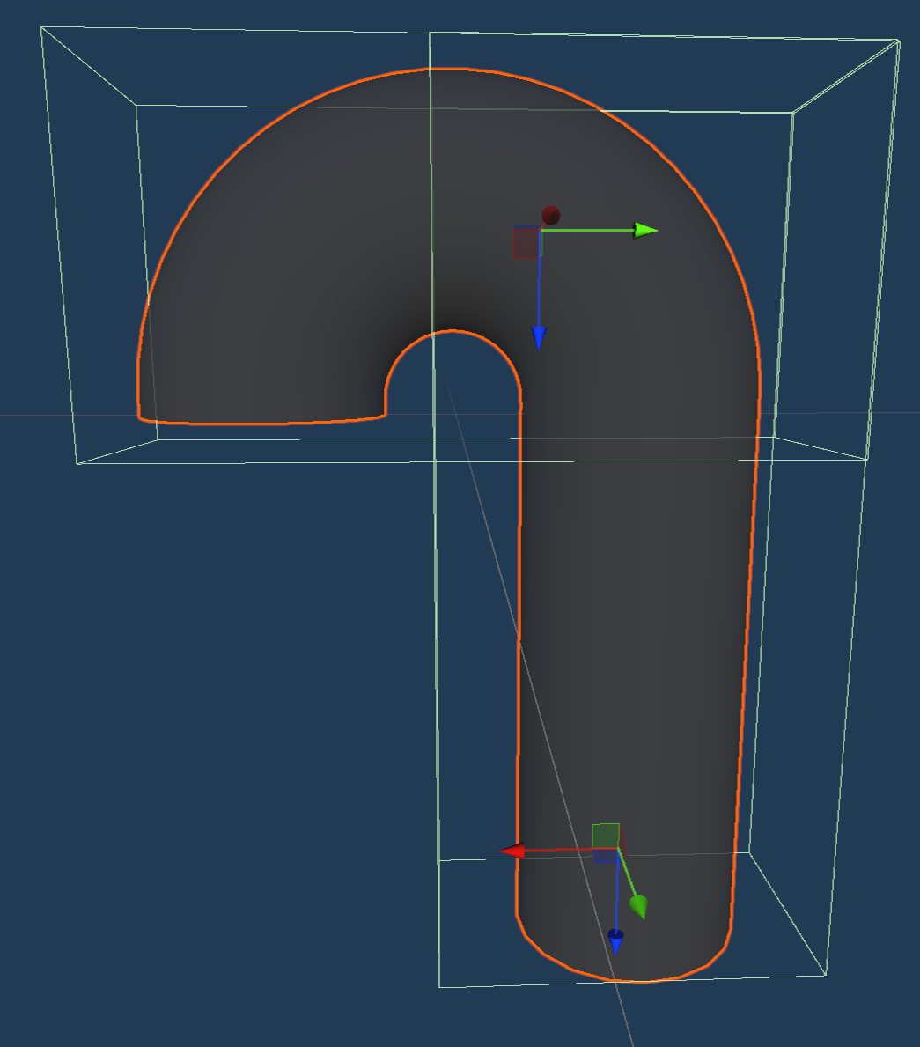
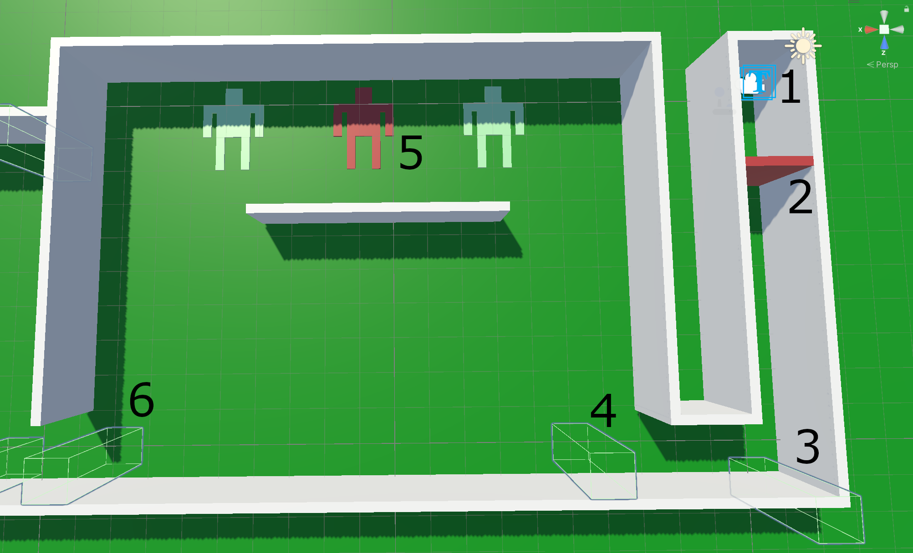
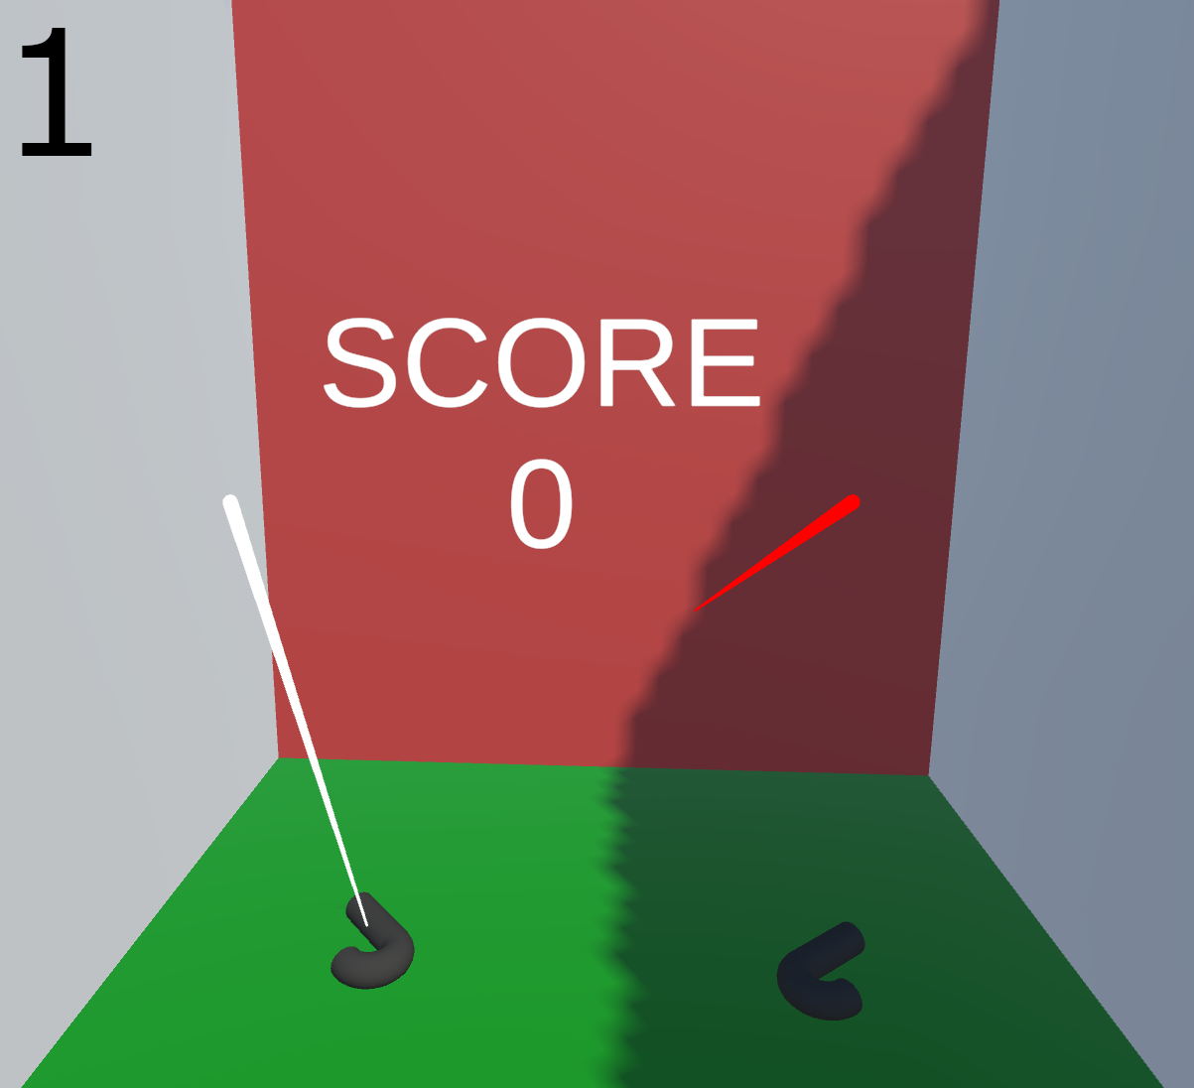


TEMPTARE
An ATTEMPT at Game Development in Virtual Reality
Joshua Berger
GAMEPLAY
Top Left:
Body Prefab - used for the targets
Top Right:
Blaster Prefab
Top arrow - attach point for being held in the user’s hand
Bottom arrow - spawn point for the bullets
Bottom:
The game was created using Unity, a game development engine
User’s spawn point
When the red wall is shot, the user moves towards Point 3
CameraDirectionChanger - on collision, the user moves towards Point 4
CameraBodyFlipper - on collision, the targets at Point 5 flip up
Targets - green are friendly, red are hostile
CameraStopper - on collision, user’s motion stops
A closer look at the user’s spawn point:
The score is displayed above the user’s head at all times during the game
Two blasters are at the user’s feet and can be picked up
Shooting the red wall will destroy it and the starts the game
Temptare
METHODS
INTRODUCTION
Assets
ReadMe
Index.html
Created unique Prefabs and Materials using Unity’s Manual Interface
Made numerous scripts from starting the user’s movement to controlling the bullets with C#
Inspiration:
Call of Duty: Modern Warfare II
Men In Black: Alien Attack (Universal)
Training Course from MWII
Ride mechanics and concept from MIB
How gun safety is integrated in the game:
Counts the number of times the gun is pointed at friendly targets
Shooting a friendly target ends the game
Only rewards shooting hostile targets
CHALLENGES
Scenes
XR Samples
Text Mesh Library
Scripts
Josh Berger
Controlling the User’s Movement and Collisions:
The original idea was to only recreate MWII’s Training Course
It was necessary to prevent user from walking through walls
Solutions that did not work at all
Adding a Box collider and RigidBody to camera
Transforming position was incompatible with Unity’s input controls
Solutions that worked sometimes
Moving parent’s position backward on collision
Only forwards collisions
Tried grabbing direction of camera’s velocity
Garbled
Tried saving previous positions to move back to on collision
That’s when I decided to switch to moving along a track
Prefabs
Materials
CONTEXT
Over 40,000 deaths and 85,000-130,000 injuries a year caused by firearms in the United States (Megan L. Ranney et al.)
Gun safety desperately needs to be taught to the American populace
One way to teach it is through a video game (specifically in VR)
VR can often be better than traditional learning techniques because it enhances:
Immersion, Learner Enjoyment (Motivation), Repetition
VR can be an effective means of eliminating risks
Not giving beginners actual guns
Hopefully, making such a game will reduce the number of casualties from gun violence in the US each year
http://github.com/joshberger5/SeminarProject

